Slide 1



The Search for Volatile Carbon Transport in Protoplanetary Disks
Ruby Fulford
Dr. Kamber Schwarz
The University of Arizona Lunar and Planetary Laboratory

Slide 2
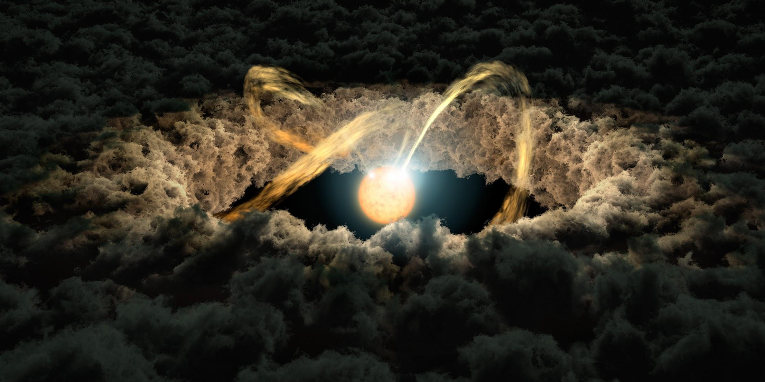
Protoplanetary Disks
Disks of gas and dust surrounding young stars
Form from the interstellar medium
Serve as accretion disks to stars and are the material from which planets form
Understanding their composition is important to understanding planetary composition and formation
Credit: NASA/JPL-Caltech
Notes:
There are lots of pretty artist interpretations of disks and even very nice ALMA images. Do a google search and pick one to add pizazz to this slide
Cut ”captured by star’s gravity”. While the disk is gravitationally bound to the star, the disk and star material all collapsed together. The star did not form first and then pull the disk material in.

Slide 3
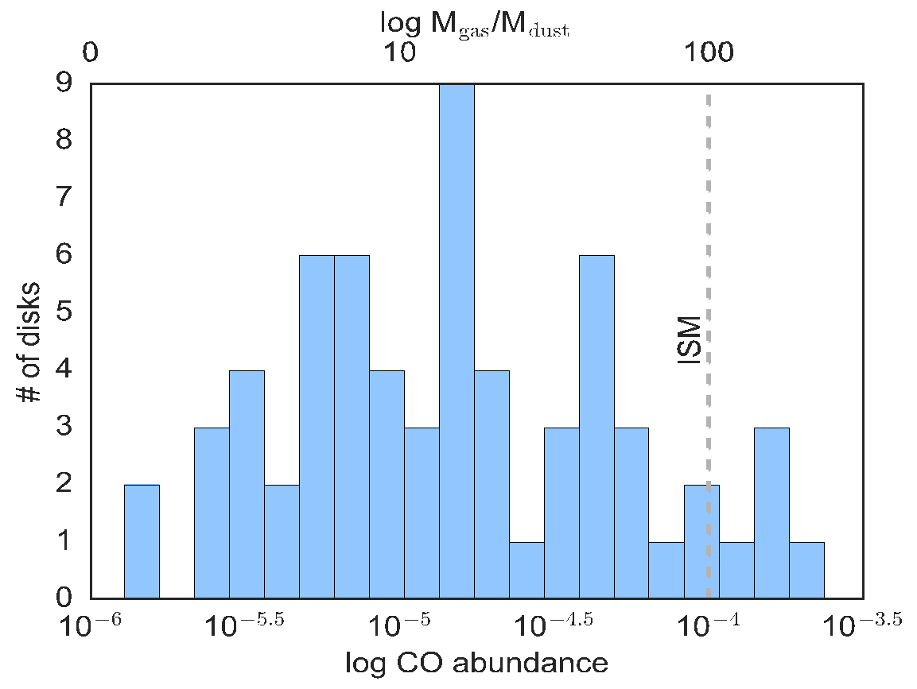
Carbon Deficiency
Many protoplanetary disks are carbon poor
CO abundance (relative to H2) from disks tends to be lower than interstellar medium CO abundance
Credit: Schwarz, Ansdell+ 2016, Long+ 2017,Williams & Best 2014
Notes:
CO flux -> CO abundance (relative to H2)
Make plot bigger and credit. I made the plot but the data is from the surveys of Williams & Best 2014 (for the Taurus region) Ansdell et al. 2016 (Lupus) and Long et al. 2017 (Chameleon) You don’t need to put the region names on the slide but you should know what they are. Can list them in the notes if you want.

Slide 4
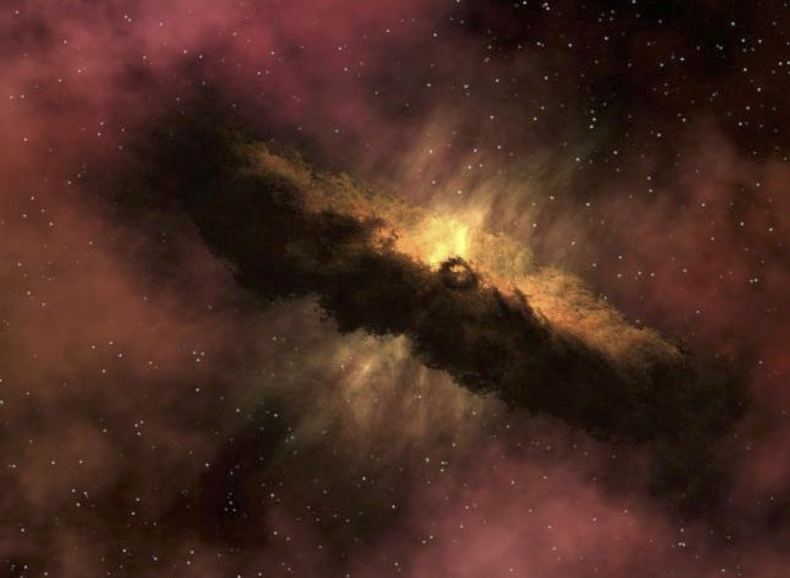
Hypothesis & Objective
CO gas condenses onto grains in the cold outer disk
Radial drift that moves these grains into the inner disk
Heat from the star sublimates the CO₂ ice into gas
What is the relationship between the CO₂ flux and the CO flux from several protoplanetary disks?
Credit: Universal History Archive
Notes:
”Stellar wind creates radial drift that moves” -> “Radial drift moves” , the radial drift is due to a slight difference in velocity between the gas and the larger dust grains.
In the first bullet point there is an implied step that after the CO freezes out onto the grain chemistry turns it into CO2. You don’t need to put that on the slide, but you should know it
Far too many words on the last bullet point. Try framing it as a question.
To cut down on words the fourth bullet point can be cut entirely

Slide 5
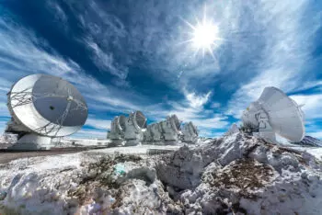
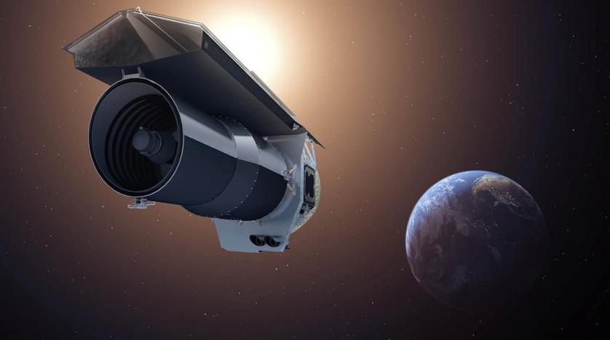
Methods
Utilized data from the Atacama Large Millimeter/Submillimeter Array (ALMA) Science Archive
Created images from the continuum and the ¹³CO and C¹⁸O spectral lines of several protoplanetary disks
Used Numpy and Matplotlib to extract the ¹³CO and C¹⁸O fluxes of each disk and plot fluxes from each line against CO₂ fluxes taken from Salyk et. al (2011)
Credit: ALMA (ESO/NAOJ/NRAO)
Credit: NASA/JPL-Caltech
Notes:
“continuums” -> “continuum”
”several” -> actual number
Image of ALMA on this slide would be nice, maybe Spizter as well.

Slide 6
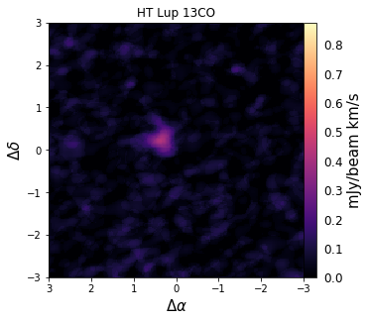
Methods
¹³CO images created for IM Lup, HT Lup, RU Lup, AS 205, GW Lup
C¹⁸O images created for IM Lup, RU Lup, AS 205
Images for TW Hya and AA Tau previously created with different weighting
CO₂ fluxes for TW Hya taken from Najita et. al 2010
Notes:
Cite Schwarz et al. 2016 at bullet point three
Make sure you know what weights are, we can talk about it if you need a refresher

Slide 7
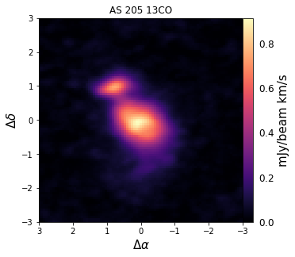
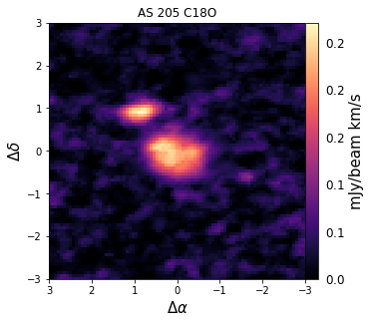
AS 205 Images

Slide 8
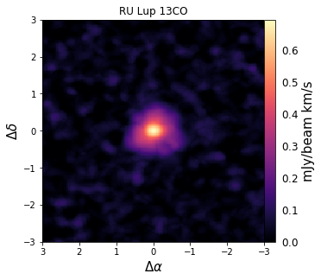
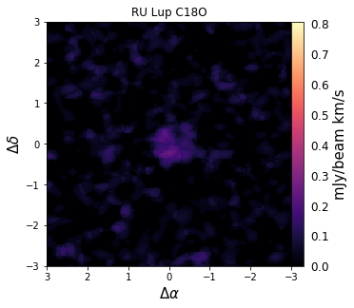
RU Lup Images

Slide 9
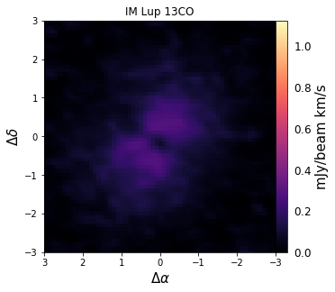
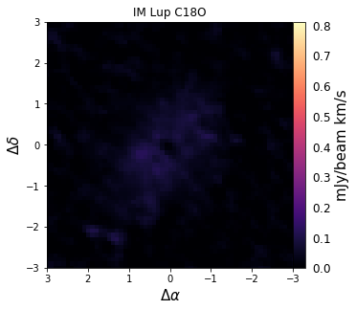
IM Lup Images

Slide 10
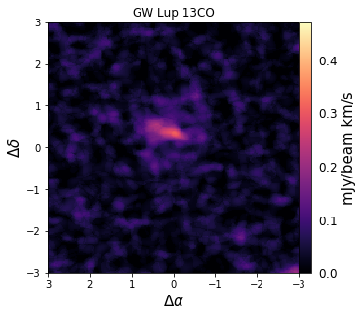
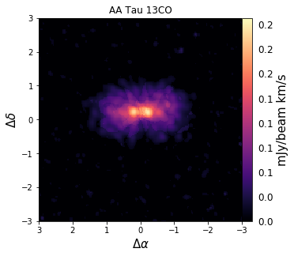
GW Lup and AA Tau Images
Credit: ALMA

Slide 11
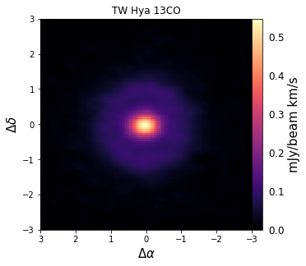
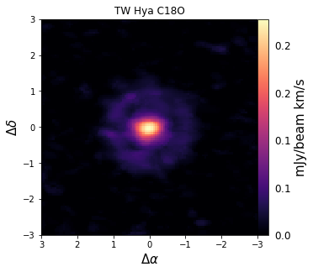
TW Hya Images
Credit: Schwarz et al. 2016

Slide 12
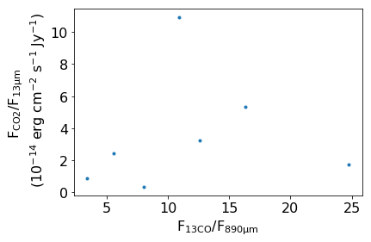
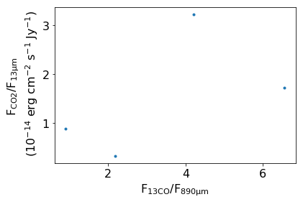
Results
CO₂ Flux vs. ¹³CO Flux
CO₂ Flux vs. C¹⁸O Flux
GW Lup
AS 205
AA Tau
IM Lup
AS 205
HT Lup
IM Lup
TW Hya
TW Hya
RU Lup
RU Lup
Notes:
Make points on the plots larger
“to” -> “too”

Slide 13
Conclusions
The expected inverse trend was not present, direct trend instead
The CO in the outer disk could be freezing and reacting with other elements to create a different substance (not CO₂)
Positive correlation could result from disks with higher carbon abundance being richer in several carbon species
M stars may have different chemistry due to different stellar properties
Notes:
“room” -> ”disk”
Start new bullet point at “The correlation”
Cut last bullet point. See email for alternative explanation

Slide 14
Acknowledgments
I would like to sincerely thank Dr. Kamber Schwarz, The University of Arizona Lunar and Planetary Laboratory, The Arizona Space Grant Consortium, and NASA for their support on this project.

Slide 15
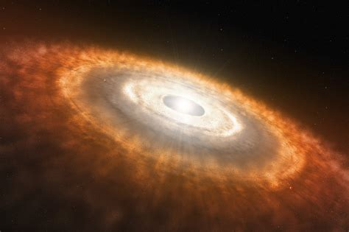
Thank You!
Credit: L. CALÇADA/ESO

